Slide 1
DRIVER ALERTNESS DETECTION
PIP104 PROFESSIONAL PRACTICE-II
VIVA-VOCE
Batch Number: CSE-G117
Roll Number | Student Name
20201CSE0650 | RAKESH H BHAT
20201CSE0635 | HEMANTH ARUN B M
20201CSE0636 | GOWTHAM T C
20201CSE0653 | CHANNAKESHAVA T
20201CSE0642 | D CHINTHAN
Under the Supervision of,
Dr. Jothish C
Assistant Professor
School of Computer Science Engineering & Information Science
Presidency University

Slide 2
Introduction
Driver alertness systems are becoming increasingly vital in the realm of road safety as they aim to mitigate the risks associated with fatigued or impaired drivers. These systems combine various technologies, including sleep detection, alcohol detection and crash detection to enhance the safety of both the driver and other road users. By continuously monitoring the driver's condition, these systems provide real-time feedback and alerts, helping to prevent accidents caused by drowsiness and intoxication. These incidents can have devastating consequences for both the individuals involved and society at large. To address these challenges, driver alertness systems have emerged as a comprehensive solution. These systems are equipped to monitor and react to various aspects of a driver's behavior and the vehicle's condition, significantly reducing the risk of accidents.

Slide 3
Literature Review
The National Highway Traffic Safety Administration found 56,000 sleep-related road crashes in the U.S.A. in 1996, and a 2007 survey revealed that 18% of accidents involved fatigue. In Britain, up to 20% of serious road accidents were attributed to fatigue. To prevent accidents caused by drowsiness, a system was developed using infrared sensors to monitor drivers' eye blink closure rates. The system issues warnings and, if necessary, reduces vehicle speed and adjusts steering to avoid collisions. Various methods, such as monitoring vehicle movement and processing electrocardiogram signals, have been proposed for drowsiness detection, with limitations. Additionally, approaches using computer vision, facial landmarks, and SVM classifiers were explored for driver distraction and phone usage detection. Commercially, breath analyzers and ignition interlock systems are widely used, while ongoing research focuses on seamlessly integrating reliable alcohol sensing technologies in vehicles to enhance safety.

Slide 4
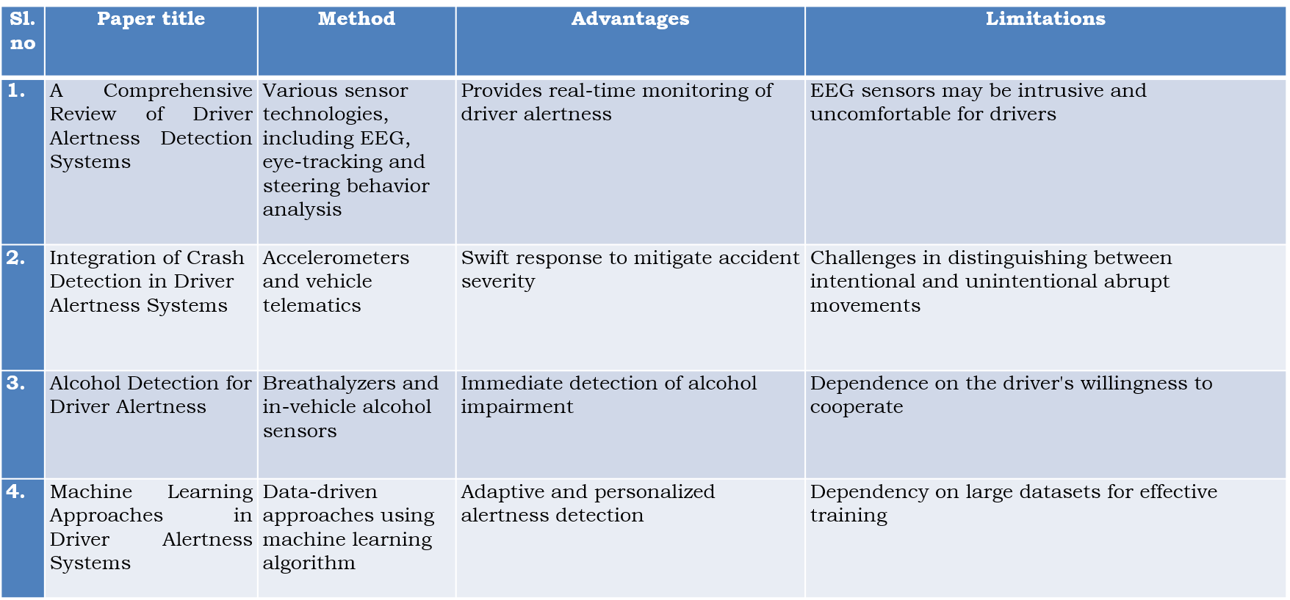
Literature Review

Slide 5
Research Gaps Identified
A prominent issue in ebb and flow driving situations is the commonness of attentional weakness, influencing a driver's response time. Driving while tired stands apart as a significant supporter of street mishaps, introducing a higher accident risk contrasted with driving in an alarm state. Tending to this worry, an assistive framework has been created to screen a driver's watchfulness level and issue cautions in the event of tiredness. The current framework centers around distinguishing sluggishness through estimations of yawning and head development. This includes continuous cycles, for example, face identification and following, mouth shape examination, yawning location in view of changes in mouth shape region and head development following. Already, sensor-worked gadgets like goggles were used for tiredness discovery utilizing MATLAB, with manual keeps an eye on the driver's circumstances prior to starting excursions. Sadly, these techniques needed ongoing notices about the driver's sluggishness, highlighting the irreversibility of life once lost in a mishap.

Slide 6
Proposed Methodology
The imagined framework is developed on the underpinning of the OpenCV picture handling library, with QT filling in as the manager. The essential accentuation is put on quick sleepiness identification and smoothed out information handling. The framework utilizes a Logitech camera to accomplish continuous location of the driver's eye state, recognizing open and shut eyes. Prominently, drivers stay detached to outer gadgets, and the probability of failing is limited. An inventive technique for recognizing driver tiredness/lethargy is carried out on an Arduino microcontroller board, consolidating readings from different sensors. This incorporates the use of a MQ-6 liquor gas sensor to distinguish liquor utilization, combined with a transfer circuit to keep the driver from working the vehicle on the off chance that liquor is recognized. Alarms are set off when the driver has polished off liquor or displays regular head gestures or shut eyes.

Slide 7
Objectives
Safety Enhancement:
The primary objective of this system is to enhance road safety by proactively identifying and addressing factors that contribute to accidents.
Drowsiness and Alcohol Detection:
Detect and alert drowsiness signs like closed eyes to keep the driver awake. Accurately identify alcohol presence in the driver's breath to prevent drunk driving accidents.
Real-time Crash Detection and Notification:
Develop a system that can reliably and accurately detect crashes using GSM-based sensors and notify emergency services and designated contacts in real-time to expedite response and aid accident victims.
Improved Emergency Response Time:
Reduce emergency response time by quickly and automatically alerting the appropriate authorities and emergency services, ensuring that injured individuals receive timely medical attention.

Slide 8
System Design & Implementation
Systems design is the process of defining a system's architecture and components to meet specified requirements. It blends marketing, design, and manufacturing into a unified product development approach. This phase bridges the gap between the problem domain and the existing system, focusing on how the system will operate. The System Design Document provides a high-level description and detailed architecture of the new system. Implementation is the realization of a technical specification through programming and deployment. In the IT industry, it involves guiding clients from purchase to software or hardware use, encompassing analysis, customization, integration, training, and delivery. Implementing a system successfully requires well-proven methodologies, professional advice, and coordination of inter-related tasks. Safety measures to prevent drunk and drowsy driving can be incorporated into the car industry, including breath sample tests for alcohol detection, face capture with eye and mouth tracking for drowsiness detection, and an alert system with alarms and seat vibrations to keep the driver awake. If a driver is found drunk or drowsy, an alarm activates, and if repeated, the system can turn off ignition and activate indicator lights for warning.

Slide 9
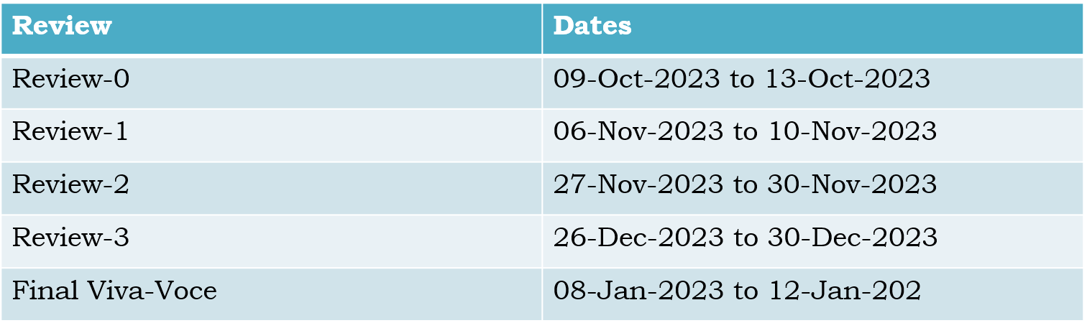
Timeline of Project

Slide 10
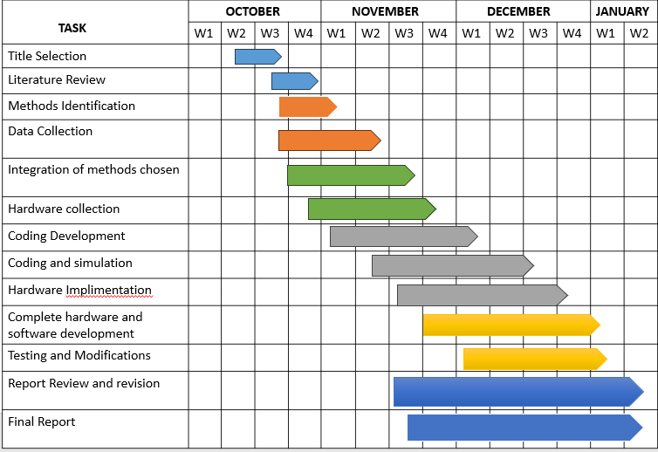
Timeline of Project

Slide 11
Outcomes / Results Obtained
The implementation of the driver alertness system is poised to bring about transformative outcomes in the realm of road safety and driving experiences. The foremost impact is expected in accident prevention, where the system's ability to significantly reduce incidents arising from drowsy driving or impaired alertness promises a safer road environment for drivers, passengers, and pedestrians alike. The real-time monitoring and alerting capabilities ensure timely intervention, providing drivers with immediate warnings and opportunities to address signs of drowsiness promptly. This proactive approach not only prevents potential accidents but also fosters a heightened sense of awareness among drivers about their own alertness levels and the associated risks. The system's customization features further enhance the user experience by adapting to individual driver preferences and variations in driving behavior. In commercial settings, the implementation of such systems is anticipated to lead to enhanced fleet safety records, translating to reduced operational costs, improved corporate reputation, and an overall increase in fleet efficiency. As these outcomes materialize, the driver alertness system becomes a pivotal tool in reshaping road safety practices and cultivating a culture of responsible and vigilant driving.

Slide 12
Conclusion
A spearheading driver sharpness identification framework has been advanced, based on continuous exhaustion location. This inventive methodology adroitly recognizes indications of eye flickering and sluggishness. The technique includes the usage of picture handling calculations to gain data about the eyes' situation, offering a harmless means to identify sluggishness without causing bother or obstruction. Moreover, a face acknowledgment calculation has been utilized, yielding a solid estimation of the flicker rate.
Essentially, the proposed calculation shows adaptability, successfully recognizing eyes under differing light levels and autonomous of orientation and age. Be that as it may, ideal discovery execution is accomplished when the camera is situated obviously. To counter the expected effect of unfortunate recognition in low-light circumstances, a night vision camera has been coordinated, guaranteeing unrivaled outcomes unaffected by splendor levels. The framework consolidates a signal pointer to caution the driver, adding to upgraded street security.

Slide 13
References
Z. Xiaorong et al, ―The Drunk Driving Automatic Detection System Based on Internet of Things‖, International Journal of Control and Automation.
J. Dai, J. Teng, X. Bai, Z. Shen, and D. Xuan. "Mobile phone based drunk driving detection." In 2010 4th International Conference on Pervasive Computing Technologies for Healthcare, pp. 1-8. IEEE, 2010
A. R. Varma, S. V. Arote, C. Bharti, and K. Singh. "Accident prevention using eye blinking and head movement." IJCA Proceedings on Emerging Trends in Computer Science and Information Technology-2012 (ETCSIT2012) etcsit1001 4 (2012)
V. Savania, H. Agravata and D. Patela , ―Alcohol Detection and Accident Prevention of Vehicle‖, International Journal of Innovative and Emerging Research in Engineering, Volume 2, Issue 3, 2015, pp 55-59
"Eye detection and recognition in the fatigue warning system." Intelligent Networks and Intelligent Systems (ICINIS), 2010 3rd International Conference on IEEE, 2010.

Slide 14
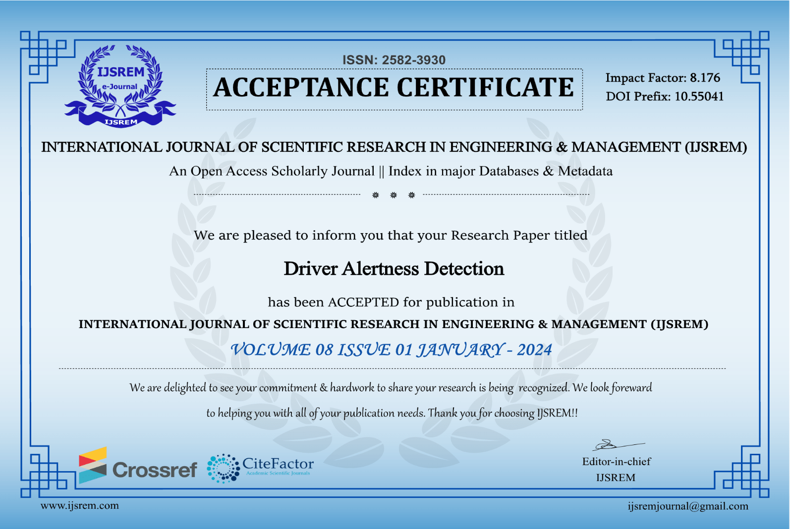
Publication Details

Slide 15
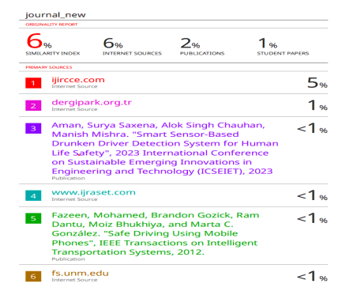
Publication Details

Slide 16

Thank You

